Slide 1

Duke MIDS
Capstone Symposium
VOICE OF THE
POLICYGENIUS
CUSTOMER
Lexin Lu
Michelle Van
Godwin Anguzu
Deekshita Saikia
March 31, 2023

Slide 2


ABOUT COMPANY
NY-based online insurance marketplace that allows consumers to compare and purchase insurance policies from a variety of providers
Products
Life, Home, Auto, Renters, Long-Term Disability, and Pet insurance
Motivation
Understand customer feedback in-depth
Improve customer retention

Slide 3

SURVEYS -- QUANT SCORE
Customers who withdrew
Customer Satisfaction (CSAT) Survey
How would you rate your overall satisfaction with the insurance application process?
1: Extremely Unsatisfied
5: Extremely Satisfied

Slide 4
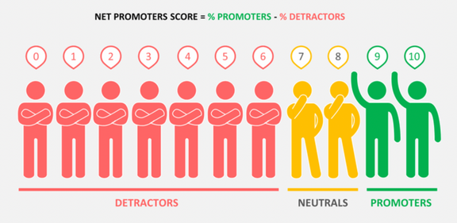
SURVEYS -- QUANT SCORE
Customers who withdrew
Customers who applied successfully
Customer Satisfaction (CSAT) Survey
Net Promoter Score® (NPS) Survey
How would you rate your overall satisfaction with the insurance application process?
How likely would you be to recommend our company to a friend?"
1: Extremely Unsatisfied
0-6: Detractors
7-8: Passive
9-10: Promoters
5: Extremely Satisfied

Slide 5
SURVEYS -- QUANT SCORE
Overall NPS = %Promoters - %Detractors

Slide 6
SURVEYS -- QUANT SCORE
Overall NPS = %Promoters - %Detractors
Policygenius
78

Slide 7
SURVEYS -- QUANT SCORE
Overall NPS = %Promoters - %Detractors
Policygenius
Industry Average
78 >> 39

Slide 8
SURVEYS -- QUANT SCORE
Still plenty of upside
Policygenius
Upside
78 < 100

Slide 9
SURVEYS -- QUANT SCORE
Still plenty of upside
Policygenius
Upside
78 < 100
How do we get there?

Slide 10


CURRENT PROCESS
Comment
Overcontact
High Quote
Slow Process
Stop emailing me after I asked over and over again.
The price was high.
Costs were too much for my budget
I have been waiting since May 2021 !
Harassing calls, texts, and emails.
Long horrible experience & still didn't offer a policy.
Problems:
Challenging
Labor-Intensive
Time-Consuming

Slide 11

GOAL
Build an Automated Topic Extraction Pipeline

Slide 12
GOAL
Build an Automated Topic Extraction Pipeline
1
Build text analysis models to identify key topics and explore historical trends

Slide 13
GOAL
Build an Automated Topic Extraction Pipeline
1
2
Build text analysis models to identify key topics and explore historical trends
Develop an automated computational topic extraction pipeline

Slide 14
GOAL
Build an Automated Topic Extraction Pipeline
1
2
3
Build text analysis models to identify key topics and explore historical trends
Develop an automated computational topic extraction pipeline
Design an analytics dashboard

Slide 15


METHODS
Unsupervised Learning Approach - Topic Modelling
STRUCTURAL TOPIC MODELLING
(STM)
LATENT DIRICHLET ALLOCATION (LDA)
NON-NEGATIVE MATRIX FACTORIZATION (NMF)
BERTOPIC
Evaluation Metrics
COHERENCE SCORES
PERPLEXITY SCORES
DIVERSITY SCORES
INTERTOPIC DISTANCE MAP

Slide 16

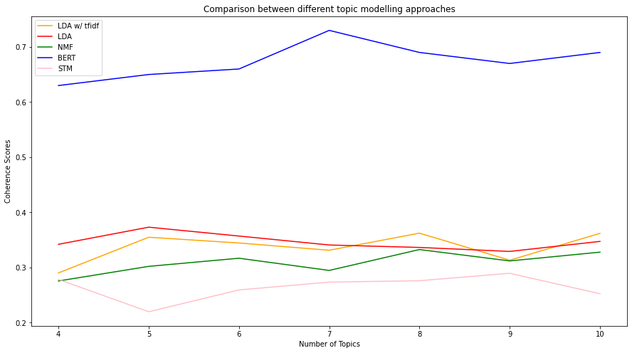
COMPARISON OF METHODS
COHERENCE SCORE : DEGREE OF SEMANTIC SIMILARITY AMONG WORDS IN A TOPIC
BERTopic

Slide 17
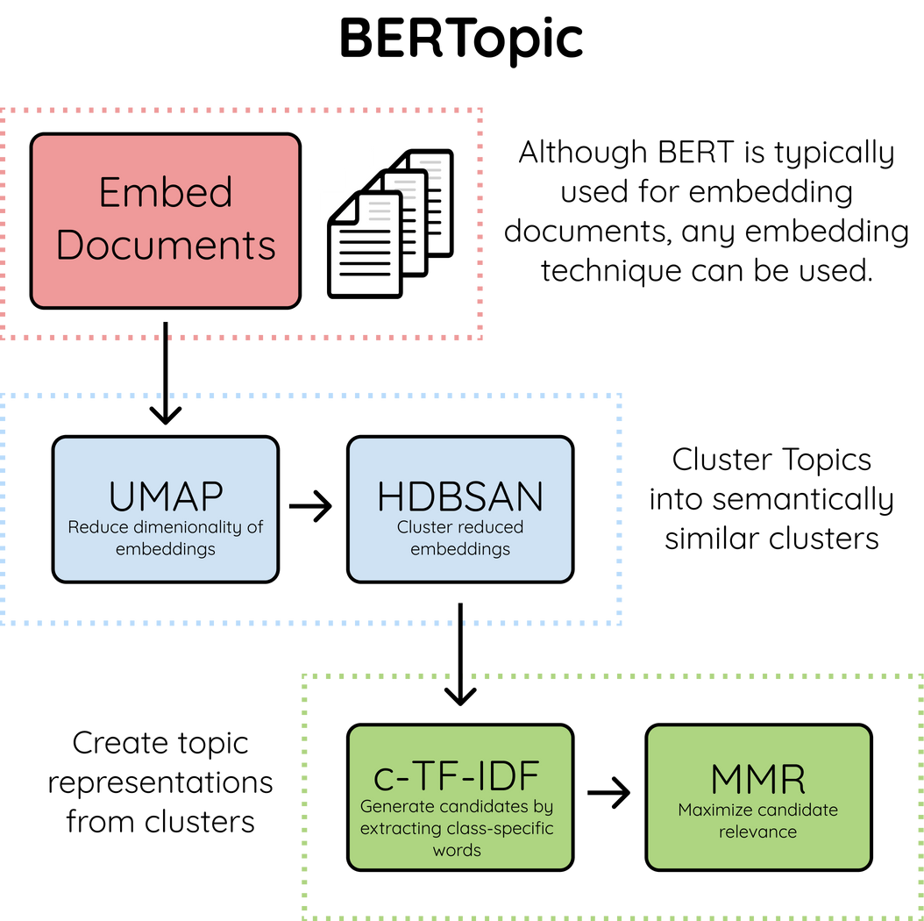
BERTOPIC
Features:
Density-based clustering algorithm
More flexible & interpretable
Semantic embeddings to account for a word's context
Better at handling short texts
Good for noisy datasets

Slide 18

APPROACH
Prepare Data
Subsetted data to 4 segments:
Promoters
Passives
Detractors
CSAT
NPS

Slide 19
APPROACH
Prepare Data
Model Building &
Fine-tuning
Subsetted data to 4 segments:
Promoters
Passives
Detractors
CSAT
Build BERTopic models individually for the 4 segments
Fine-tune each model to determine the number of topics by coherence score
NPS

Slide 20
APPROACH
Prepare Data
Model Building &
Fine-tuning
Interpret Results
Subsetted data to 4 segments:
Promoters
Passives
Detractors
CSAT
Build BERTopic models individually for the 4 segments
Fine-tune each model to determine the number of topics by coherence score
Employed combination of human interpretation and BERTopic results to
identify key themes
NPS

Slide 21
EXTRACTED TOPICS
PASSIVES
Seamless experience
Uncomfortable sharing personal info
Responsive CSRs
Long
medical process
Calls in place of online quotes
Good coverage
Great CX
PROMOTERS
CSAT
Easy process
Misleading
Process guidance
Long overall process
Excessive contact
Podcast/radio recommendation
Poor communication
High quotes
Poor coordination
DETRACTORS

Slide 22


EXTRACTED TOPICS
PASSIVES
Seamless experience
Uncomfortable sharing personal info
Responsive CSRs
Long
medical process
Calls in place of online quotes
Good coverage
Great CX
PROMOTERS
CSAT
Easy process
Misleading
Process guidance
Long overall process
Excessive contact
Podcast/radio recommendation
Poor communication
High quotes
"It was really easy to use, and I got twice the coverage for the same price as my old life insurance."
Poor coordination
DETRACTORS

Slide 23
EXTRACTED TOPICS - Passives, CSAT
PASSIVES
"Had to follow up several times and they claimed they were reaching out for medical records but my doctor had no records of this. I ultimately had to take care of this."
Seamless experience
Uncomfortable sharing personal info
Responsive CSRs
Long
medical process
Calls in place of online quotes
Good coverage
Great CX
PROMOTERS
CSAT
Easy process
Misleading
Process guidance
Long overall process
Excessive contact
Podcast/radio recommendation
Poor communication
High quotes
Poor coordination
DETRACTORS

Slide 24
EXTRACTED TOPICS
PASSIVES
There was a massive screw-up when your company laid-off my agent before she was able to complete my insurance order. I was left waiting, with no insurance and no answered or returned calls, for more than two days.
Seamless experience
Uncomfortable sharing personal info
Responsive CSRs
Long
medical process
Calls in place of online quotes
Good coverage
Great CX
PROMOTERS
CSAT
Easy process
Misleading
Process guidance
Long overall process
Excessive contact
Podcast/radio recommendation
Poor communication
High quotes
Poor coordination
DETRACTORS

Slide 25
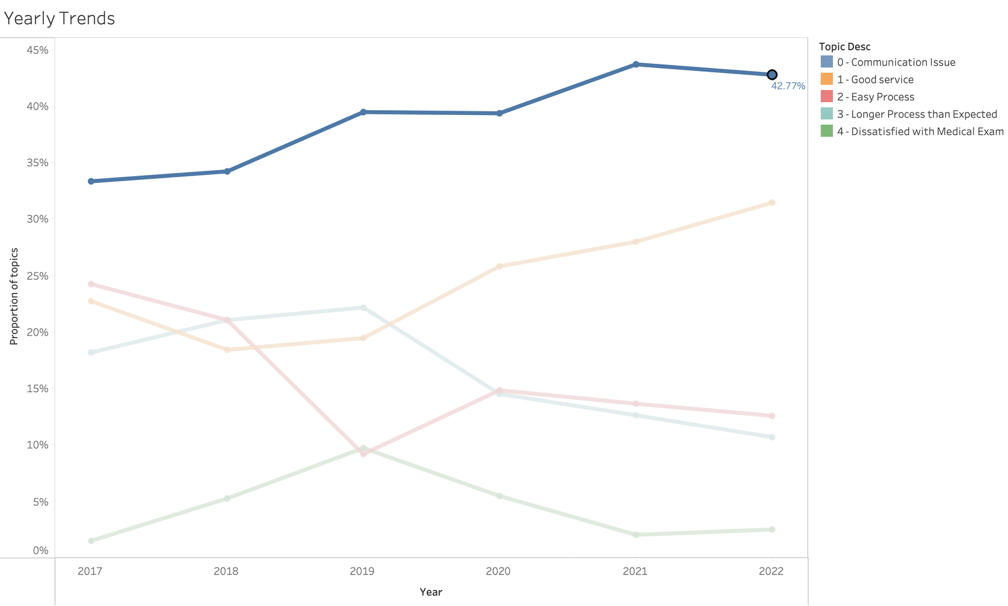
TRENDS OF TOPIC PROPORTIONS- PASSIVES
People have been unhappy with being overcontacted, which is an ongoing issue, and this seems to be a growing problem.

Slide 26
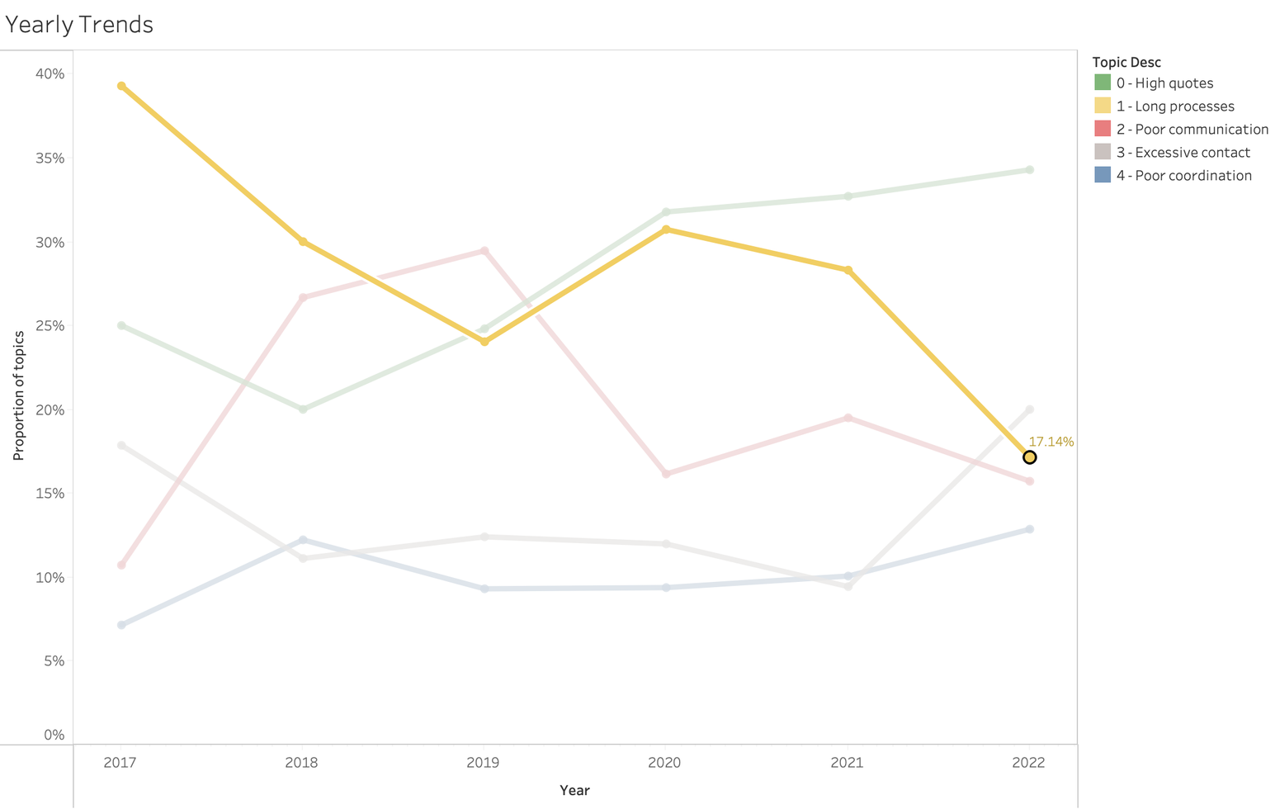
TRENDS OF TOPIC PROPORTIONS- DETRACTORS
Downward trend confirmed by Pg, updates to the application process were rolled out since 2019

Slide 27
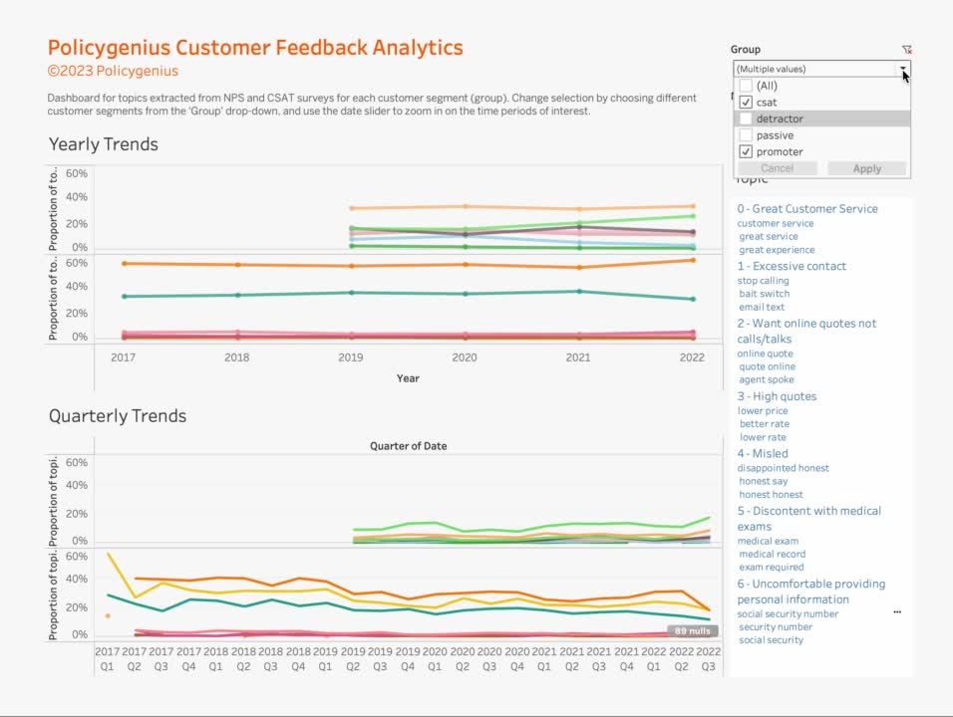
DASHBOARD

Slide 28

LIMITATIONS
Sampling Bias
All customers may not be equally likely to receive a survey

Slide 29

LIMITATIONS
Sampling Bias
Non-response Bias
Customers responding to surveys were different from those who didn't
All customers may not be equally likely to receive a survey

Slide 30

LIMITATIONS
Sampling Bias
Non-response Bias
Customers responding to surveys were different from those who didn't
All customers may not be equally likely to receive a survey
Limited Data
Only ~13000 records in NPS and ~3000 in CSAT with feedback

Slide 31
LIMITATIONS
Sampling Bias
Non-response Bias
Customers responding to surveys were different from those who didn't
All customers may not be equally likely to receive a survey
Limited Data
Effect of Noise
Only ~13000 records in NPS and ~3000 in CSAT with feedback
Difficult to isolate the effect of noise in trends

Slide 32

CONCLUSION
What do we have?
An automated pipeline to process raw text and extract key topics and trends
Positive outcome: Our findings correlate with those of Pg

Slide 33
CONCLUSION
What do we have?
An automated pipeline to process raw text and extract key topics and trends
Positive outcome: Our findings correlate with those of Pg
Where do we go from here?
Deliver an end-to-end production ready visualization tool using our pipeline
Possible future work around applying this pipeline to ingest data from social media

Slide 34



That's a wrap!
Questions?
Special Thanks
Brenna Hayes, Policygenius
Emily Nightingale, Policygenius
Dustin Tucker, Policygenius
Greg Herschlag, Duke
Jason Byers, Duke
Ryan Huang, Duke

Slide 35
Appendix

Slide 36
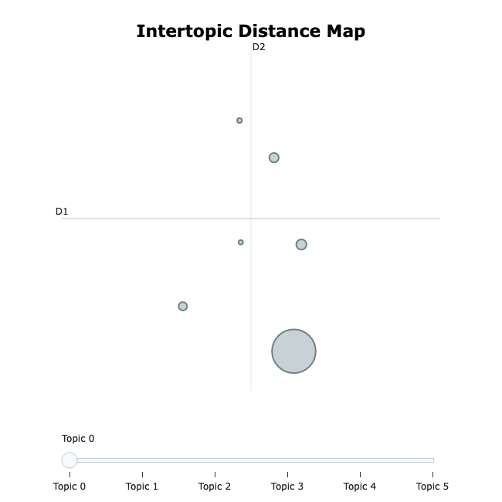
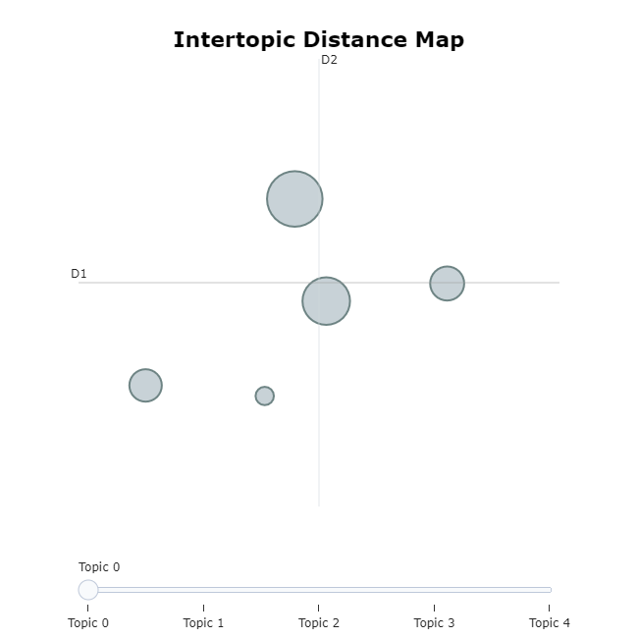
RESULTS
PROMOTERS
PASSIVES
Topic 4: Recommended by podcasts
Topic 2: Good coverage
Topic 0: Communication issues
Topic 2: Easy process
Topic 5: Seamless and efficient
Topic 1: Responsive CSRs
Topic 1: Good service
Topic 3: Med exam
Topic 3: Long process
Topic 4: Med exams/records
Topic 0: Easy process

Slide 37
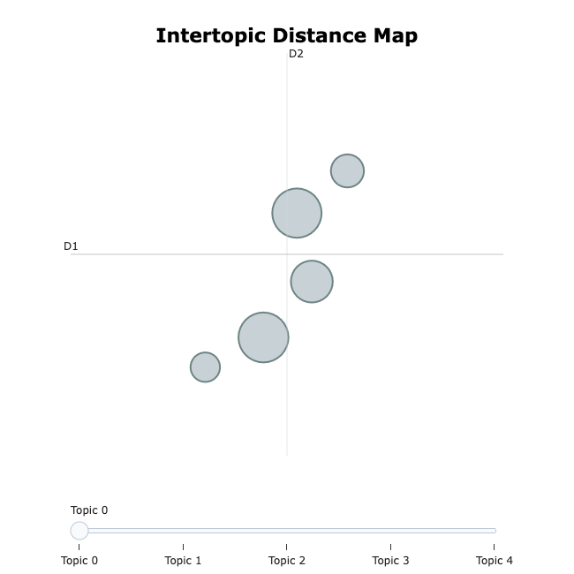
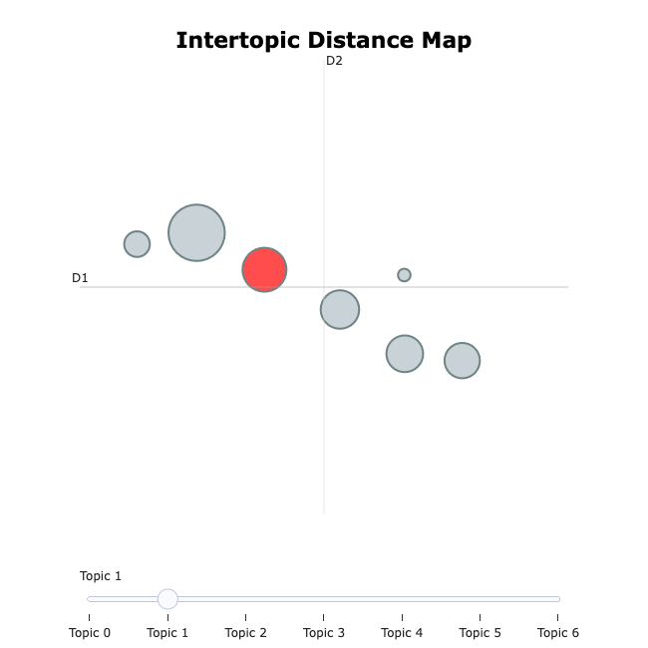

RESULTS
DETRACTORS
CSAT
Topic 3: Overcontacting
Topic 0: Great customer service
Topic 1: Poor organization
Topic 5: Unsatisfied with med exams
Topic 6: Uncomfortable sharing SSN
Topic 1: Overcontacting
Topic 3: High quotes
Topic 2: Long processes
Topic 2: Online quotes instead of calls
Topic 0: High quotes
Topic 4: Misleading/incorrect info
Topic 4: Poor communication

Slide 38
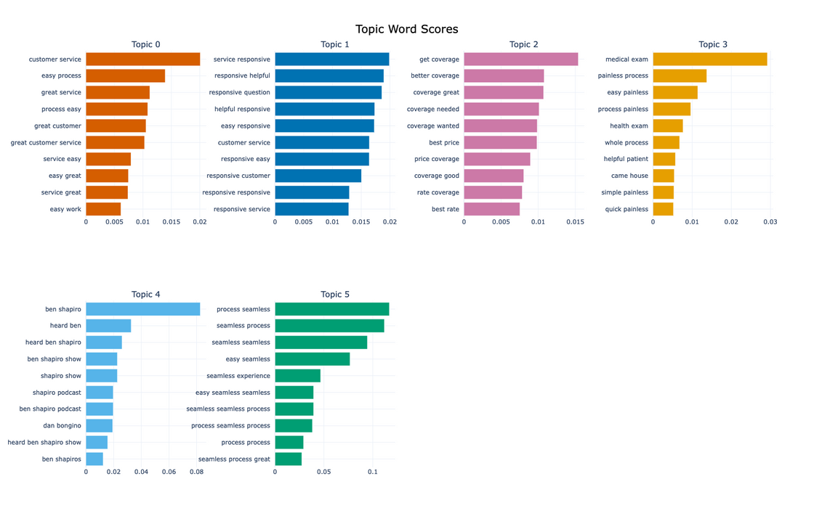
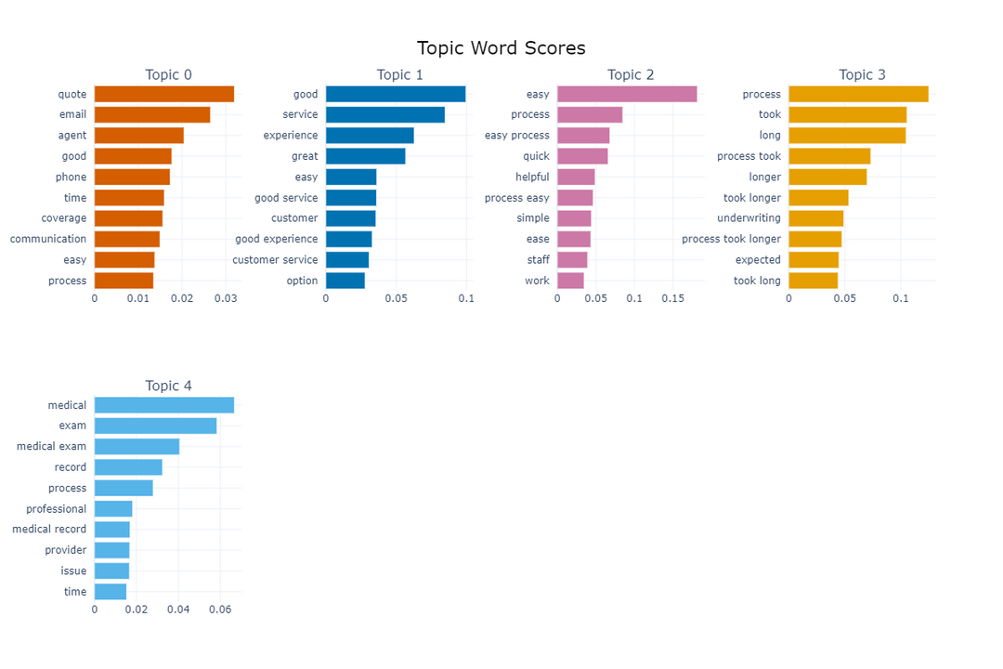
RESULTS
PROMOTERS
PASSIVES

Slide 39
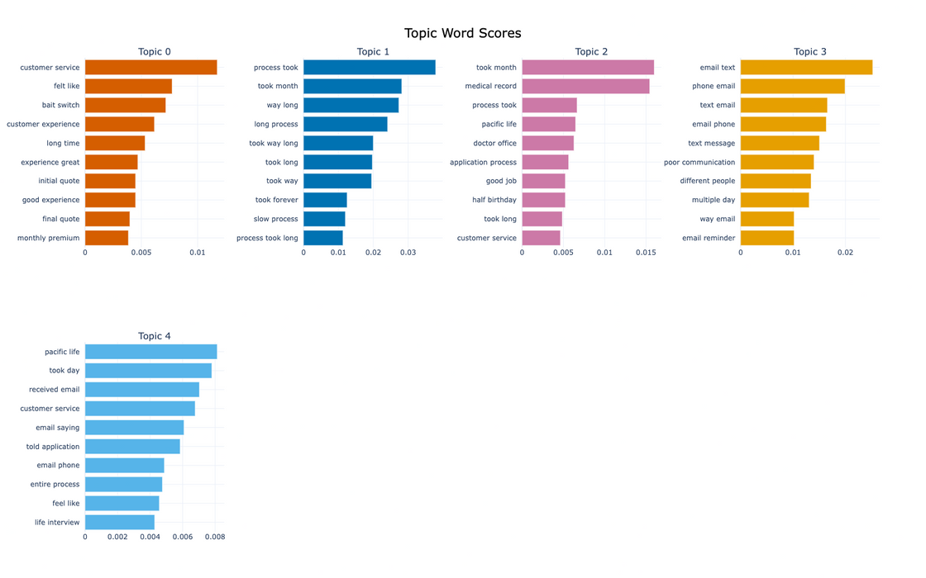
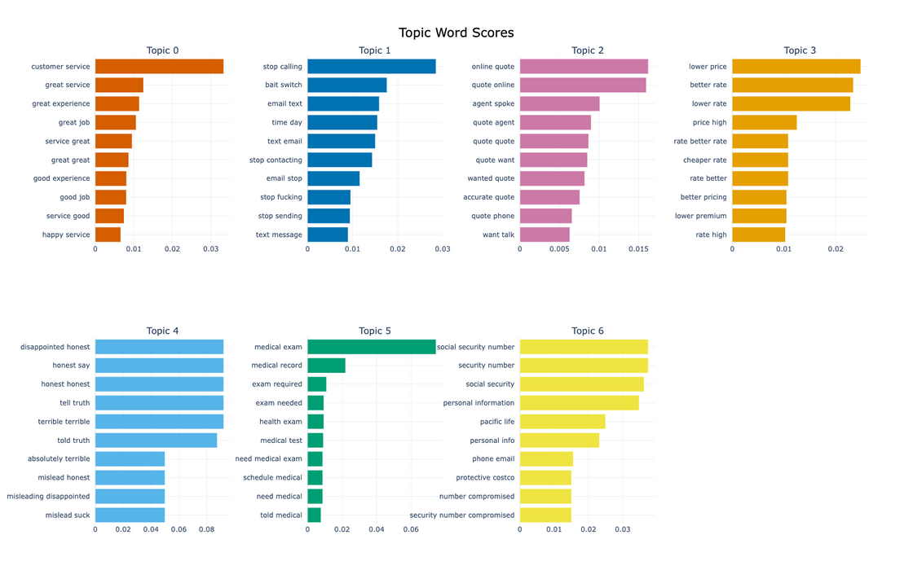
RESULTS
DETRACTORS
CSAT

